Slide 1




天津大学自然语言处理实验室
The Natural Language Processing Laboratory at Tianjin University
Towards Understanding Multi-Task Learning (Generalization) of LLMs via Detecting and Exploring Task-Specific Neurons
Yongqi Leng and Deyi Xiong*
College of Intelligence and Computing, Tianjin University, Tianjin, China
lengyq@tju.edu.cn
Yongqi Leng
Master student
@TJU
Deyi Xiong
Professor
@TJU
Notes:
Hello, everyone, I am Yongqi, from the nature language processing laboratory at Tianjin University.
I'm honored to introduce our study: Towards Understanding Multi-Task Learning (Generalization) of LLMs via Detecting and Exploring Task-Specific Neurons.

Slide 2
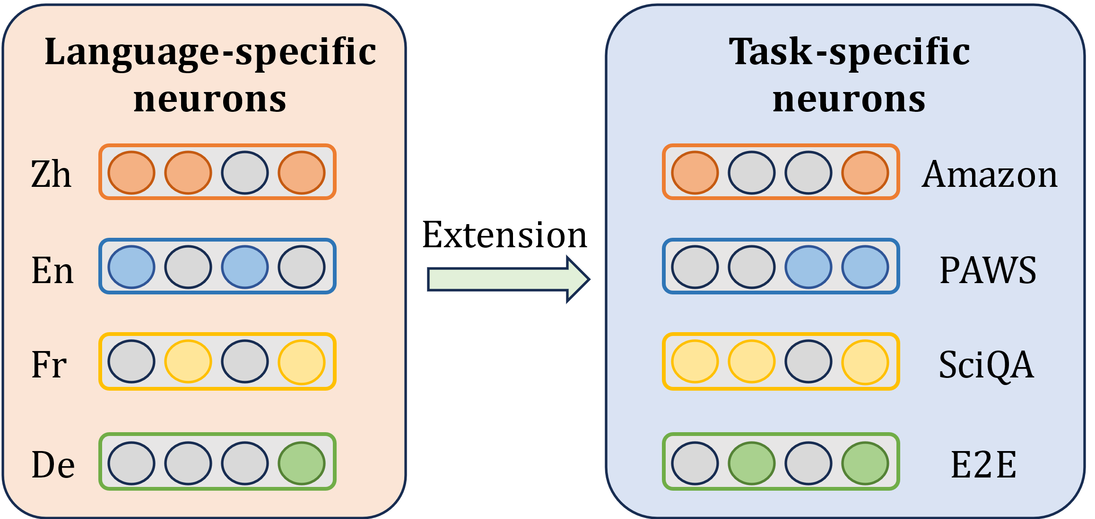
Motivation
Previous studies have demonstrated the existence of language-specific neurons in multilingual large language models (MLLMs), which have been explored to investigate the multilingual learning mechanisms. In contrast, research into the multi-task learning mechanisms of LLMs remains limited.
We argue that multilingual learning is essentially a type of multi-task learning as well.
Research Questions
Do task-specific neurons exist in LLMs?
If they exist, can they facilitate the understanding of the multi task learning mechanisms in LLMs?
Can we improve LLMs by exploring such neurons?
💡Can we extend neuronal analysis from multilingual learning to multi-task learning in LLMs?
Notes:
[The motivation for our study derives from multilingual learning. ]
1. Previous studies have demonstrated…
2. We argue that multilingual learning…
So, can we …
[In order to demonstrate the feasibility of this idea, we propose three research questions.]
- The first question, …
- The second question, …
- The last question, …

Slide 3
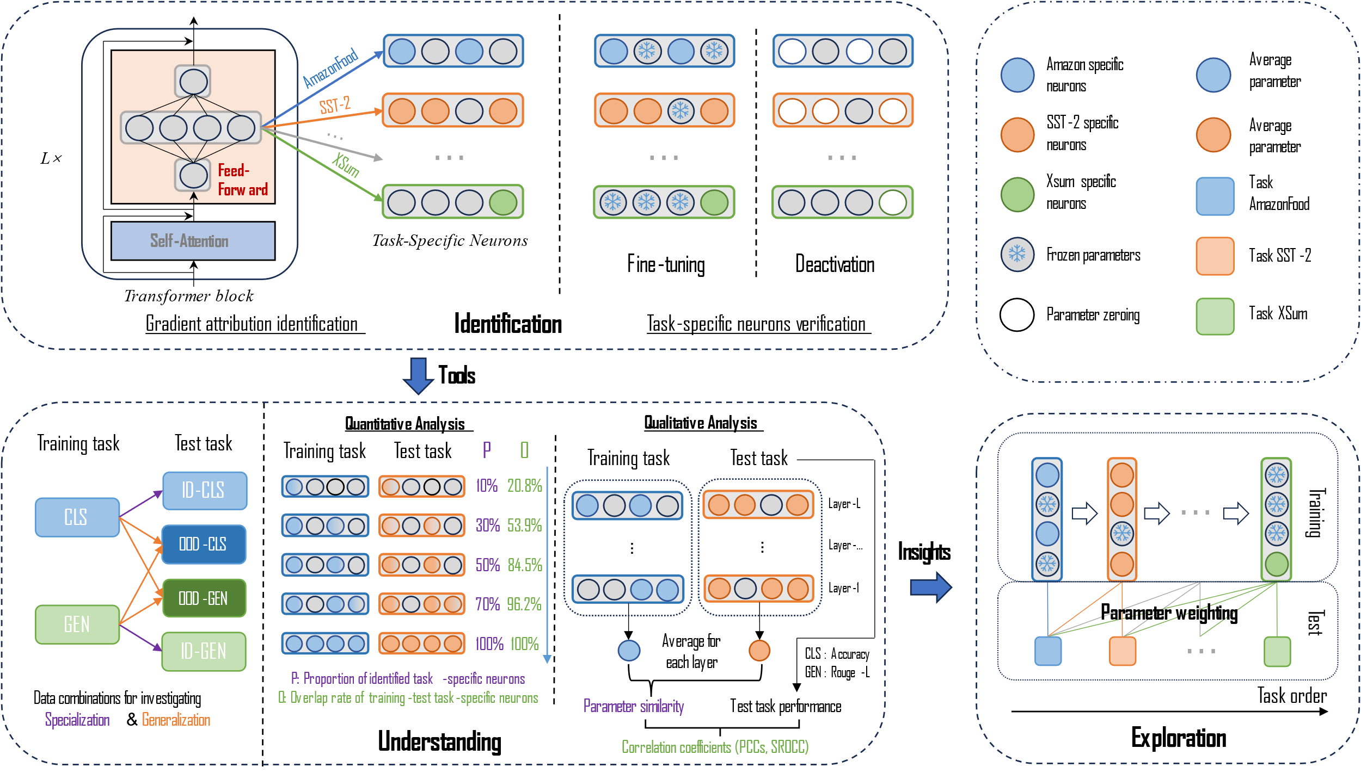
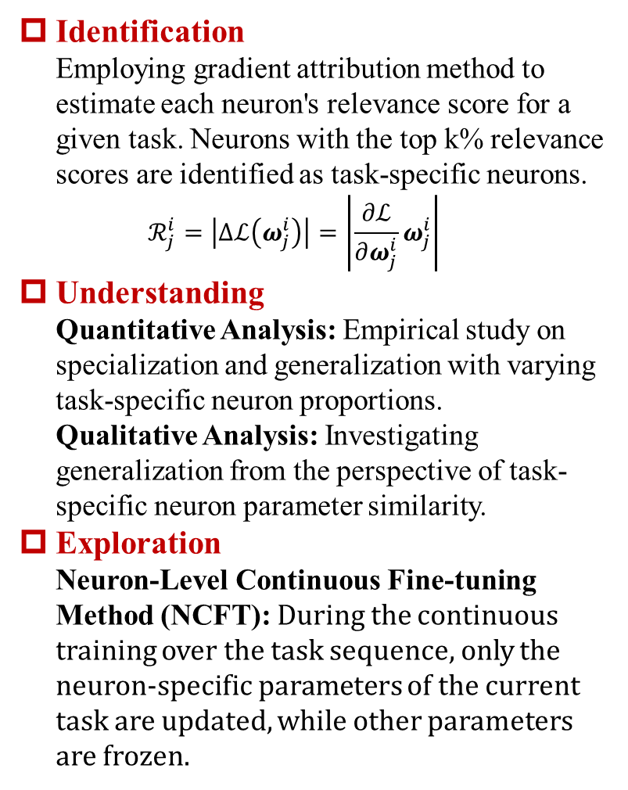
Methodology
Identification Employing gradient attribution method to estimate each neuron's relevance score for a given task. Neurons with the top k% relevance scores are identified as task-specific neurons. $ℛ_{j}^{i}=\left|Δℒ\left(ω_{j}^{i}\right)\right|=\left|\frac{∂ℒ}{∂ω_{j}^{i}}ω_{j}^{i}\right|$
Understanding Quantitative Analysis: Empirical study on specialization and generalization with varying task-specific neuron proportions. Qualitative Analysis: Investigating generalization from the perspective of task-specific neuron parameter similarity.
Exploration Neuron-Level Continuous Fine-tuning Method (NCFT): During the continuous training over the task sequence, only the neuron-specific parameters of the current task are updated, while other parameters are frozen.
The Identification component provides tools for the Understanding component which in turn provides insights for the Exploration component.
Notes:
In identification part, we employ the gradient attribution method to identify task-specific neurons.
In understanding part, we conduct qualitative and quantitative analyses on identified task-specific neurons to understand the generalization of multi-task learning.
In exploration part, we propose a neuron-level continuous fine-tuning method to mitigate catastrophic forgetting for continuous learning.
Overall, the identification component …

Slide 4
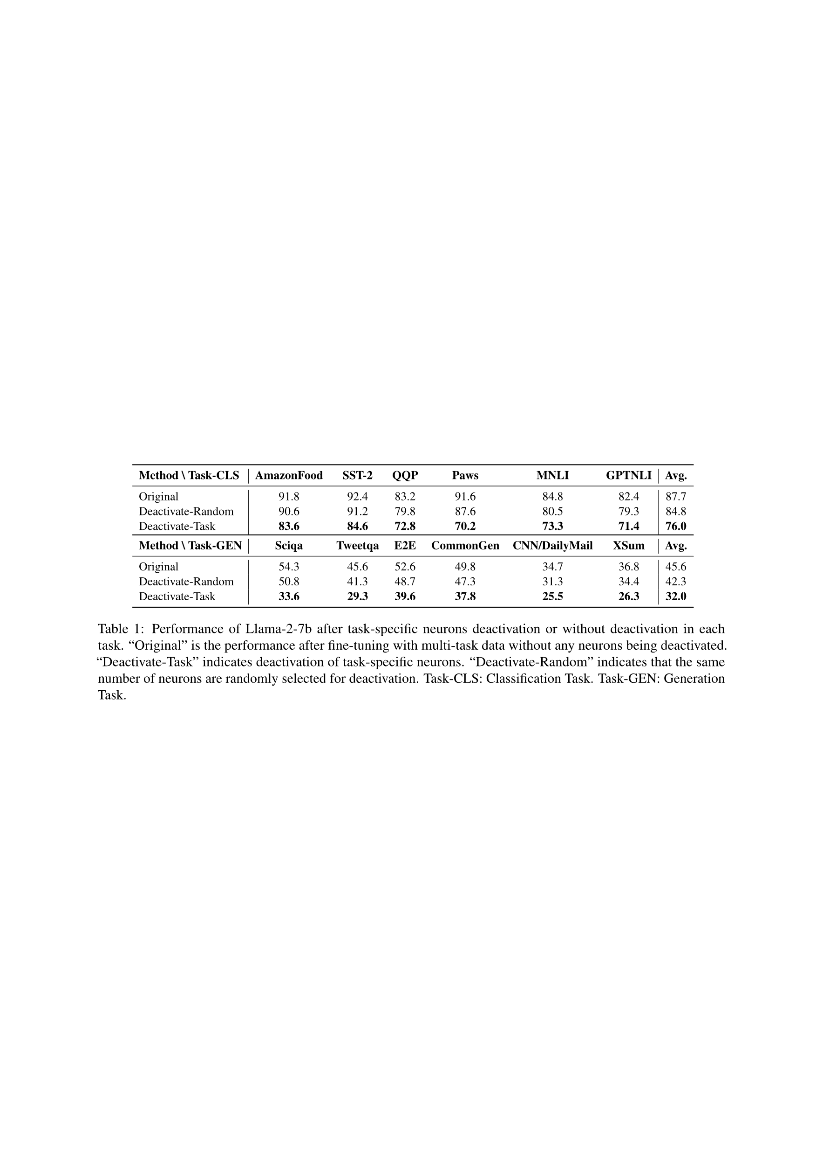
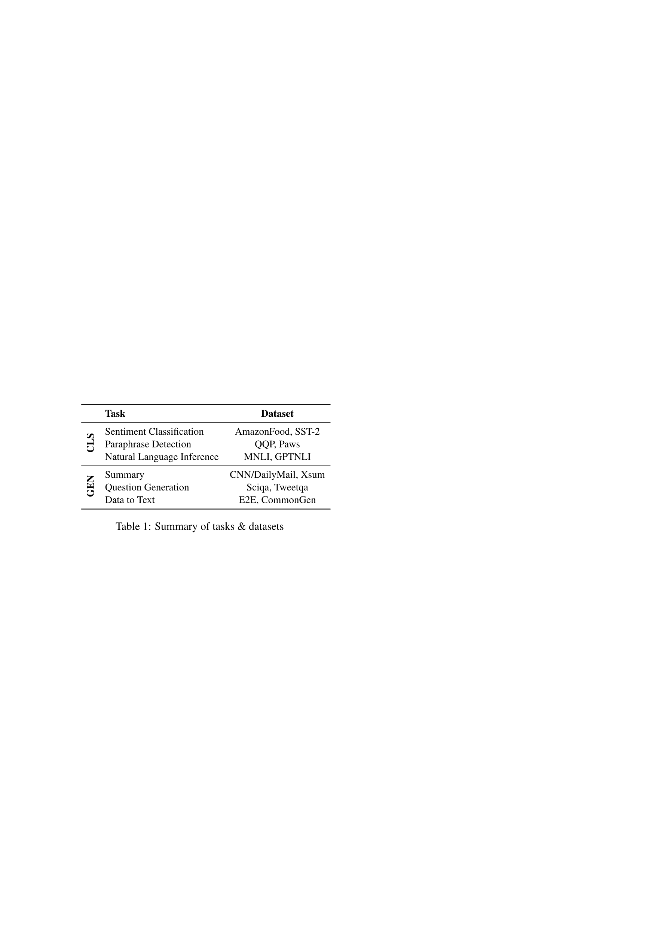
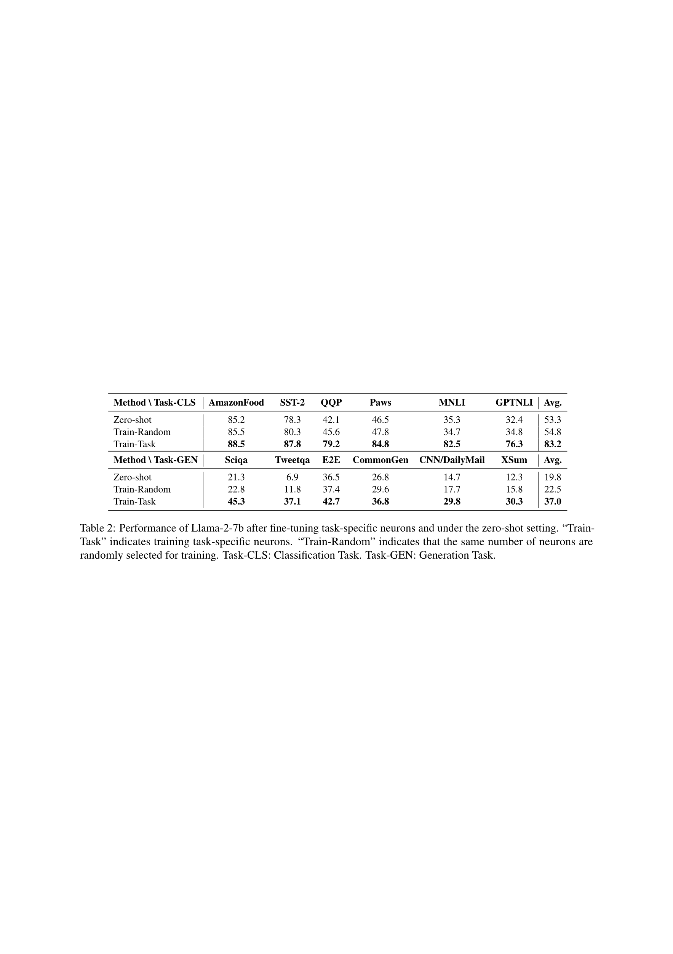
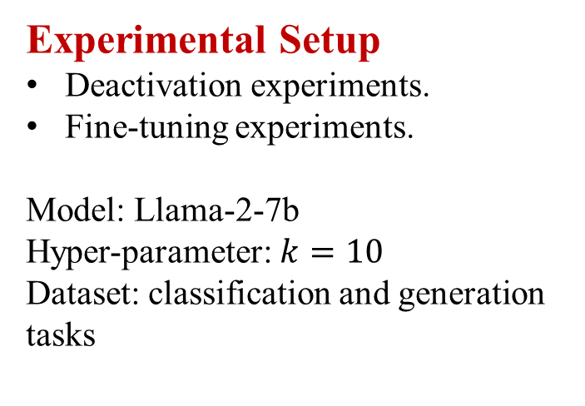
(Identification) Identifying Task-Specific Neurons
Experimental Setup
Deactivation experiments.
Fine-tuning experiments.
Model: Llama-2-7b
Hyper-parameter: $k=10$
Dataset: classification and generation tasks
Performance of Llama-2-7b after task-specific neurons deactivation or without deactivation in each task. "Original" is the performance after fine-tuning with multi-task data without any neurons being deactivated.
Summary of tasks and datasets.
Performance of Llama-2-7b after fine-tuning task-specific neurons and under the zero-shot setting.
Notes:
In this section, we conducted deactivation and fine-tuning experiments to verify the existence of task-specific neurons.
We find that although only ten percent of task-specific neurons are deactivated, it has a large negative impact on task-specific processing capacity. In contrast, deactivating the same number of randomly selected neurons resulted in a small impact. This finding also worked in the fine-tuning experiments.
Consequently, we can empirically assert the existence of task-specific neurons within LLMs.

Slide 5
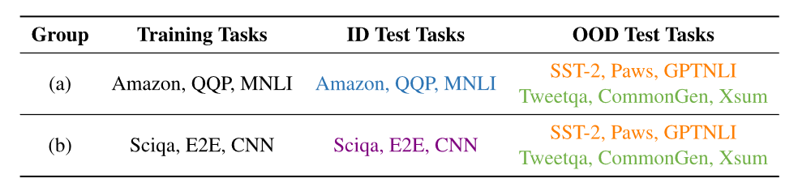
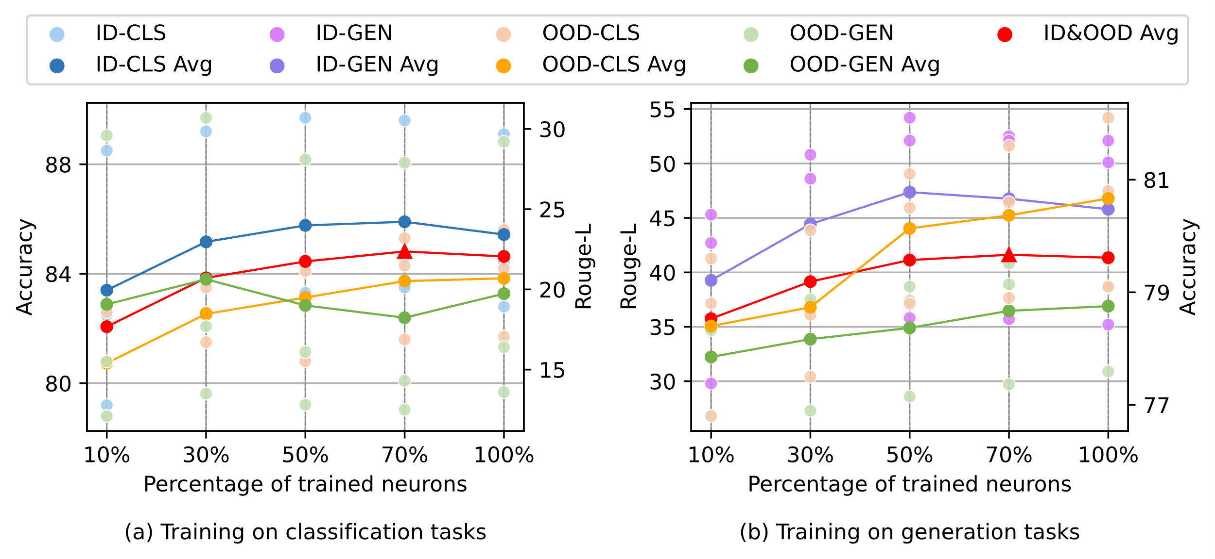
(Understanding) Quantitative Analysis
Experimental Setup
We controlled the proportion of fine-tuned task-specific neurons to investigate the trends in specialization and generalization.
Results from the in-domain (ID) test set indicate specialization performance while results from the out-of-domain (OOD) test set indicate generalization performance.
Experimental groups for exploring generalization and specialization.
Findings on Specialization
When training all parameters of the model under the multi-task learning setup, inevitable interference among tasks occurs, thereby diminishing the efficacy of individual tasks to some degree.
Our experiments show the efficacy of controlling the proportion of fine-tuned task-specific neurons as a promising strategy.
Results on classification and generation tasks after fine-tuning different proportions of task-specific neurons.
Notes:
[In quantitative analysis], we controlled the proportion …
Results from the in-domain (ID) …
[Our findings reveal that] When training all parameters …
[Furthermore,] Our experiments show …

Slide 6
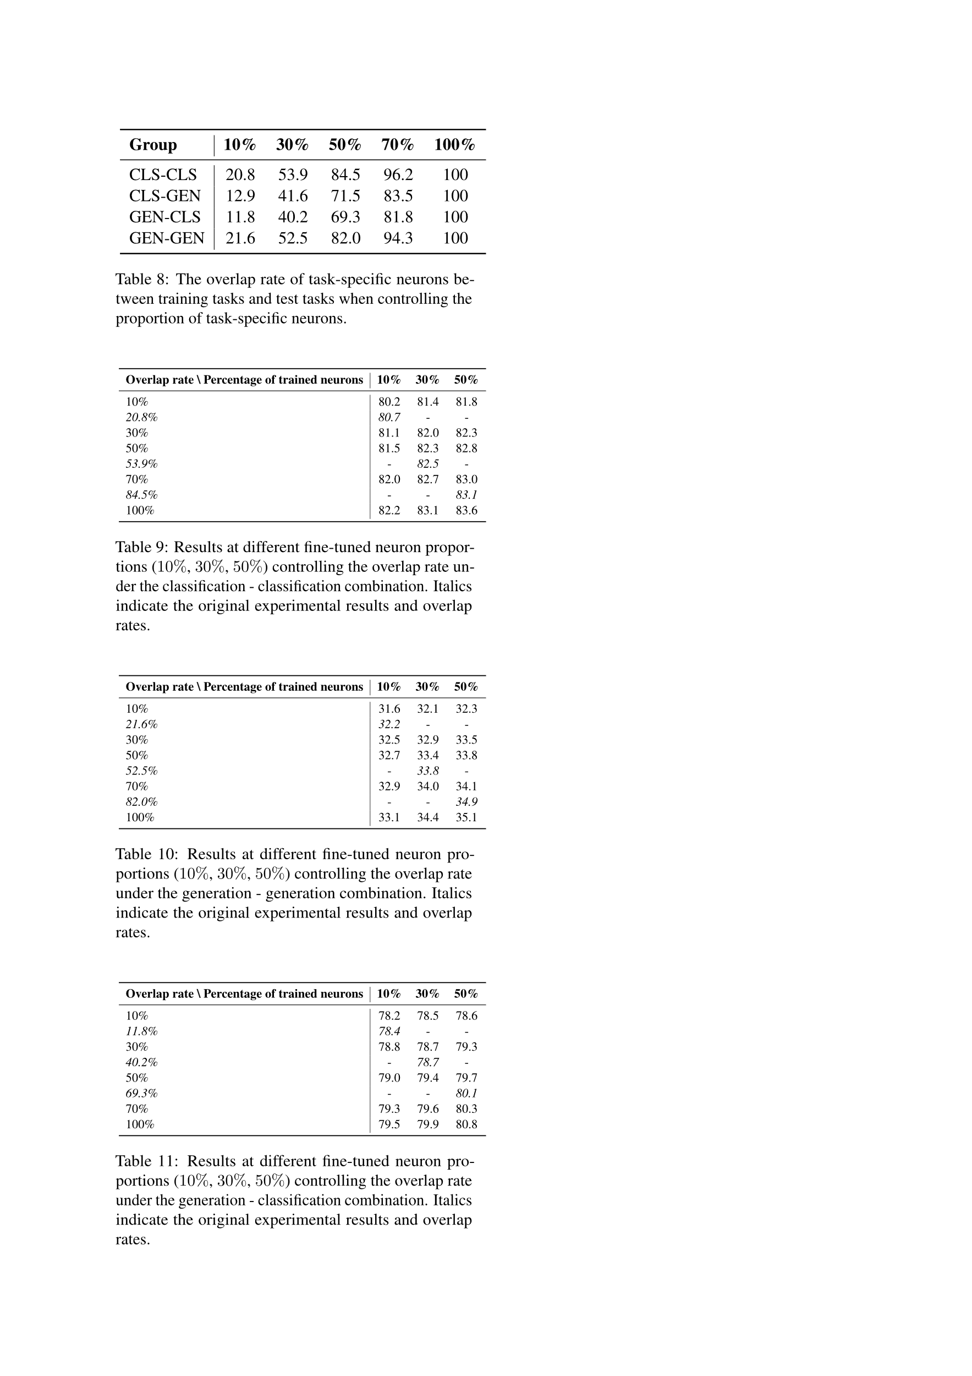
(Understanding) Quantitative Analysis
The overlap rate of task-specific neurons between training tasks and test tasks when controlling the proportion of task-specific neurons.
Results at different fine-tuned neuron proportions (10%, 30%, 50%) controlling the overlap rate under the classification-classification combination.
Findings on Generalization
Task-specific neurons overlap rates are consistent with generalization performance.
We argue that the overlap of task-specific neurons contributes to transfer learning between tasks, ultimately resulting in consistently higher generalization performance.
Results at different fine-tuned neuron proportions (10%, 30%, 50%) controlling the overlap rate under the generation-generation combination.
Notes:
[In addition, we also find that] Task-specific neurons overlap rates are...
We conducted ablation experiments to exclude the effect of the number of trained parameters.
[Finally,] We argue that the overlap of task-specific neurons …

Slide 7
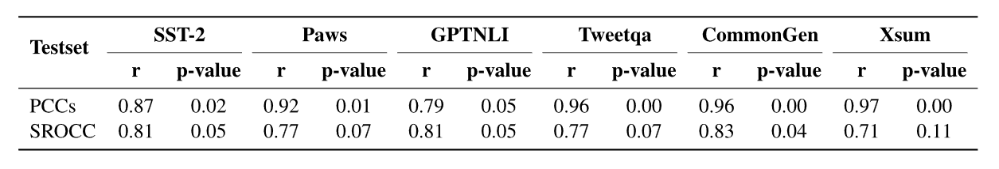


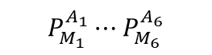

(Understanding) Qualitative Analysis
Experimental Setup
We calculate the correlation coefficients between the similarity of task-specific neuron parameters and the generalization performance.
Conclusion
These two show a positive correlation, reflecting the generalization between tasks from the perspective of parameter.
Trainset: A1, A2, A3, A4, A5, A6
$$P_{M_{1}}^{A_{1}}⋯P_{M_{6}}^{A_{6}}$$
Parameter Similarity
Model: M1, M2, M3, M4, M5, M6
$${Sim}_{M_{1}}^{A_{1}T_{3}}⋯{Sim}_{M_{6}}^{A_{6}T_{3}}$$
$$P_{M_{1}}^{T_{3 }}⋯P_{M_{6}}^{T_{3 }}$$
Testset: T1, T2, T3, T4, T5, T6
Correlation Coefficients
$$R_{M_{1}}^{T_{3 }}⋯R_{M_{6}}^{T_{3 }}$$
Result
Correlation coefficients between the similarity of specific neuron parameters and generalization performance. PCCs denotes Pearson correlation coefficients and SROCC denotes Spearman correlation coefficients.
Notes:
[In qualitative analysis, ]We calculate the correlation coefficients …
[The results show that] These two show a …

Slide 8
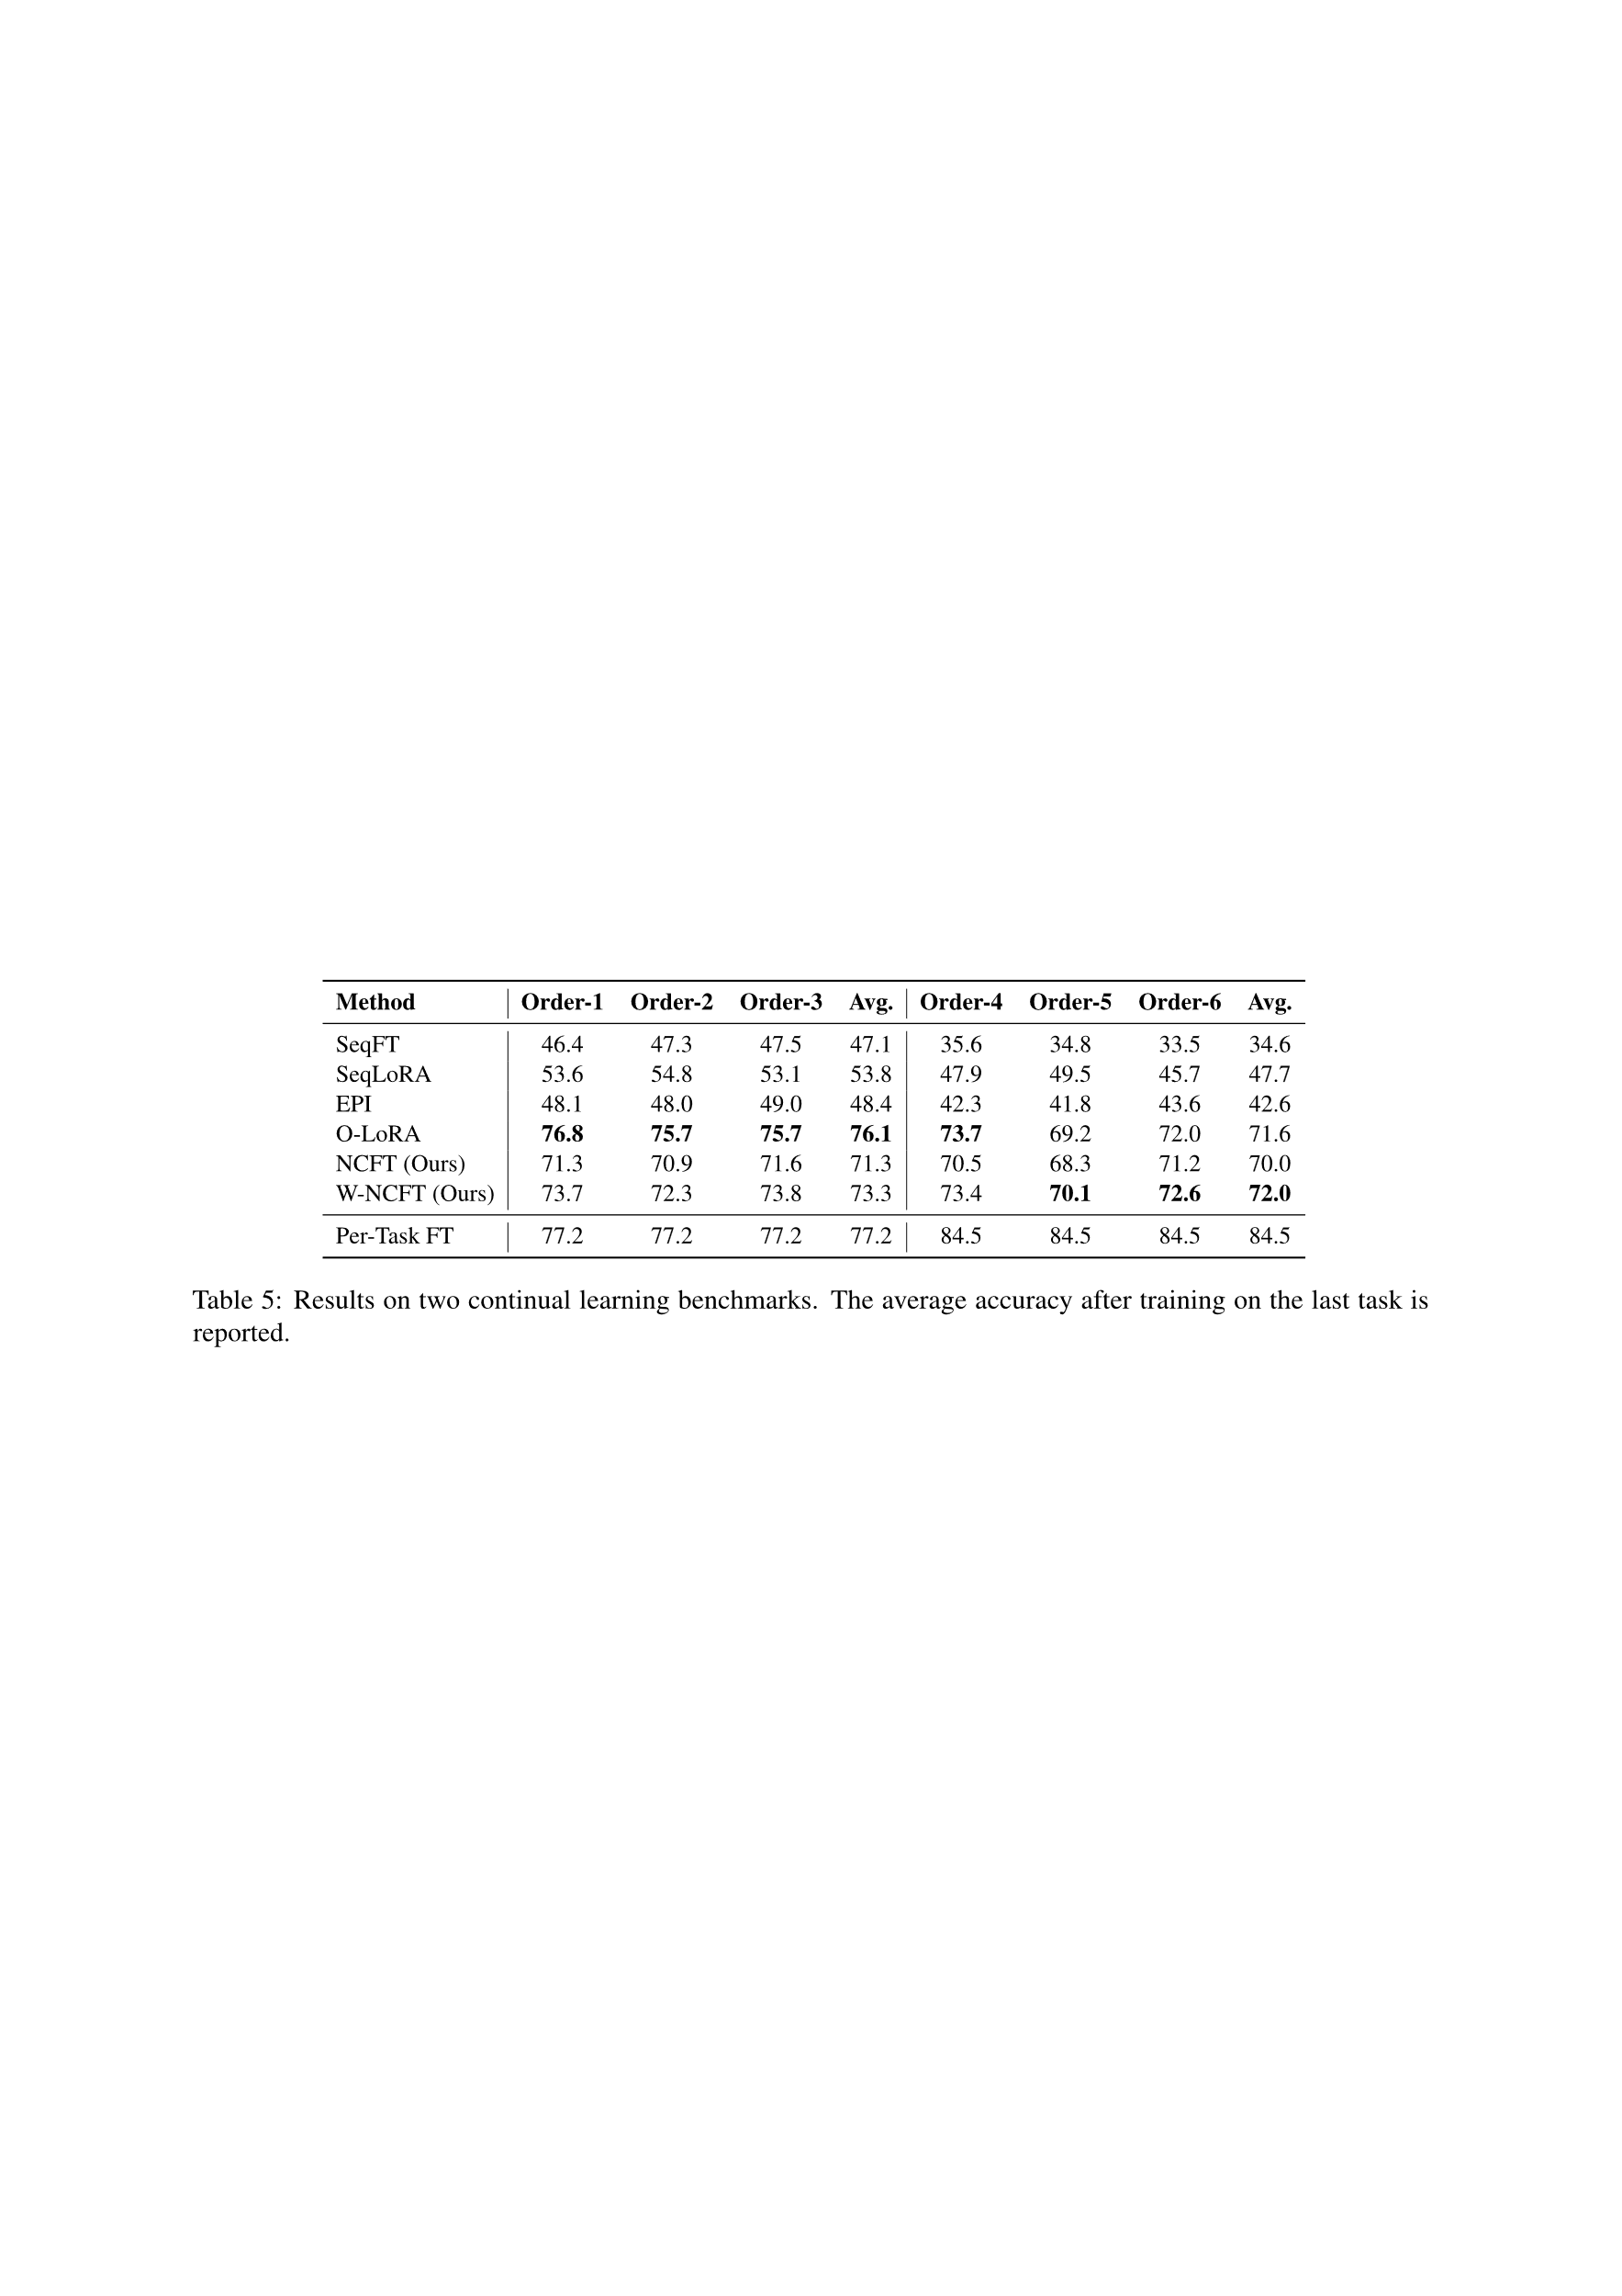
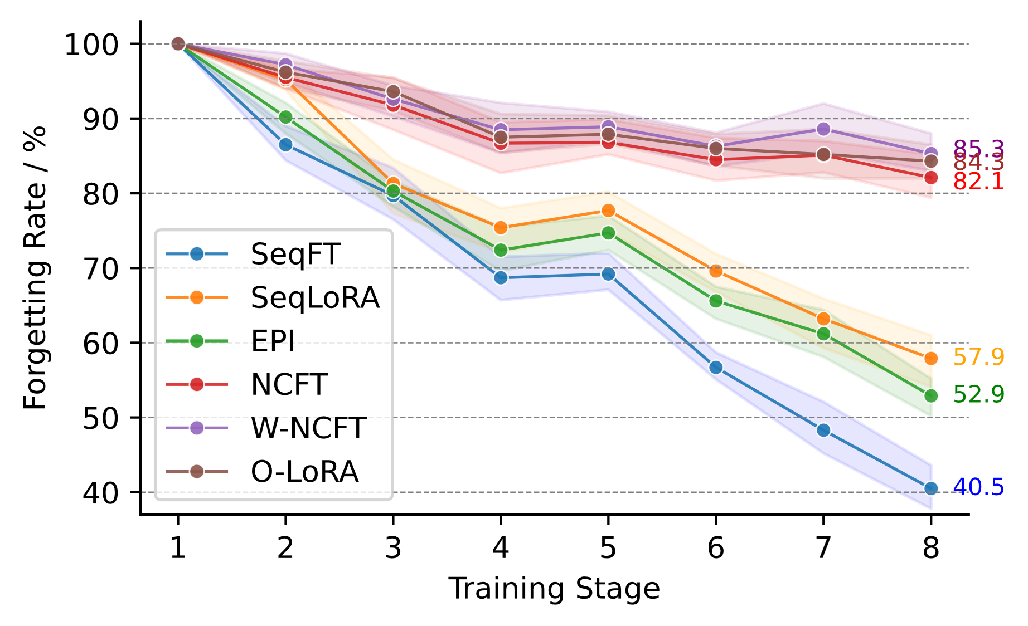
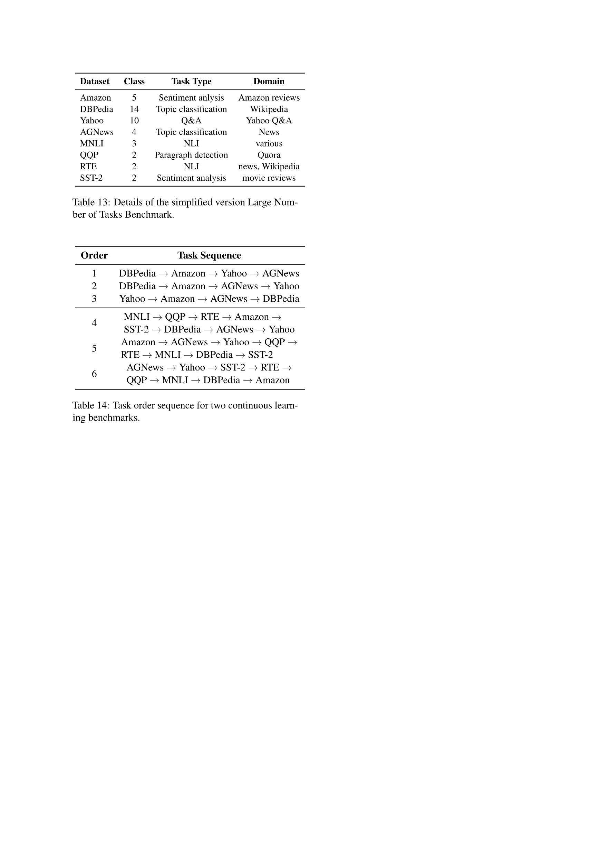
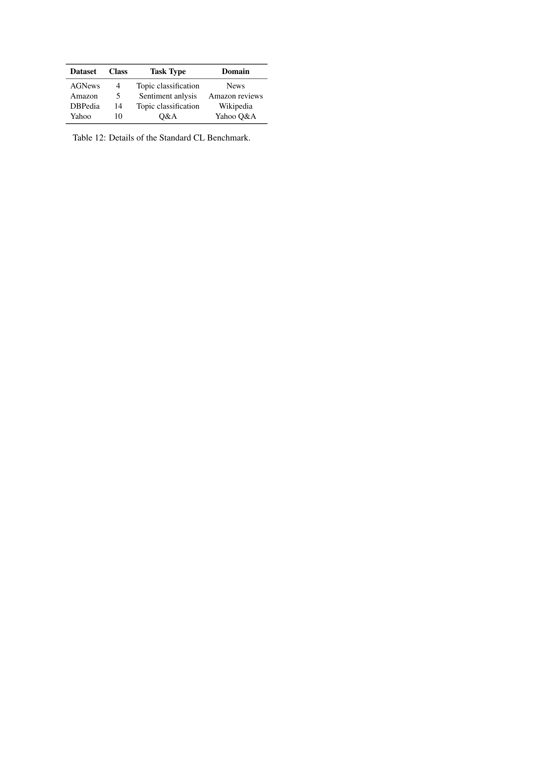
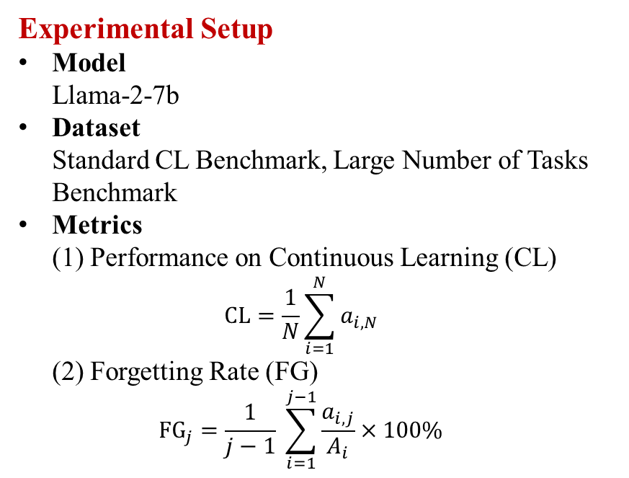
(Exploration) Mitigating Catastrophic Forgetting
Experimental Setup
Model Llama-2-7b
Dataset Standard CL Benchmark, Large Number of Tasks Benchmark
Metrics (1) Performance on Continuous Learning (CL) $CL=\frac{1}{N}\sum_{i=1}^{N}{a_{i,N}}$ (2) Forgetting Rate (FG) ${\text{FG}}_{j}=\frac{1}{j−1} \sum_{i=1}^{j−1}{\frac{a_{i,j}}{A_{i}}}×100\%$
Results on two continual learning benchmarks. The average accuracy after training on the last task is reported.
Details of the Standard CL Benchmark.
Details of the simplified version Large Number of Tasks Benchmark.
Forgetting rates for eight stages on the Large Number of Tasks benchmark.
Notes:
We finally conducted experiments on the two benchmarks of continuous learning to test the effectiveness of our proposed NCFT method.
We used continuous learning performance and forgetting rate as evaluation metrics.
Compared to baselines, our proposed method achieves improvements on both benchmarks and demonstrates lower forgetting rates at multiple stages.

Slide 9
Summary
Main Contributions
We discover task-specific neurons in LLMs empirically through extensive experiments.
We provide significant insights into generalization across tasks with our task-specific neuron analysis.
We propose a neuron-level continuous learning fine-tuning method for mitigating catastrophic forgetting, and experiments demonstrate its effectiveness.
Notes:
In summary, the main contributions of our study are as follows:
First, …
Second, …
Finally, …

Slide 10



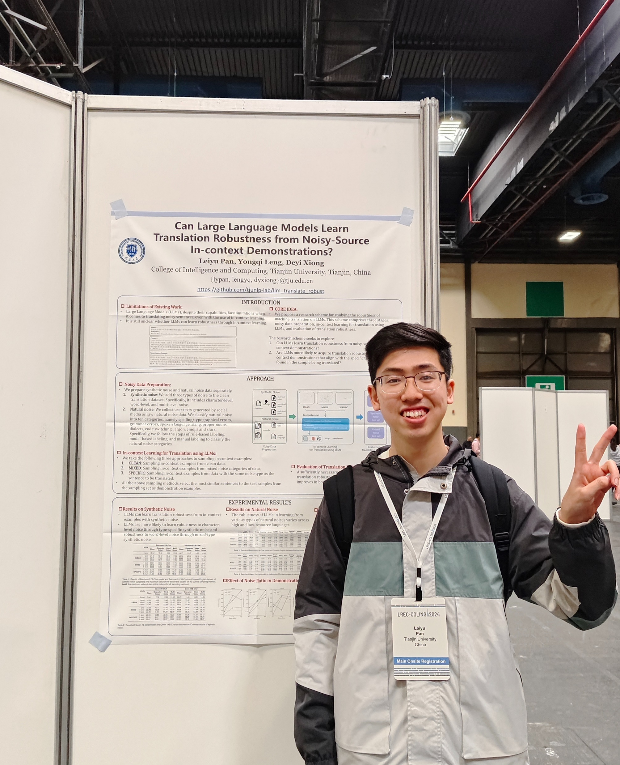
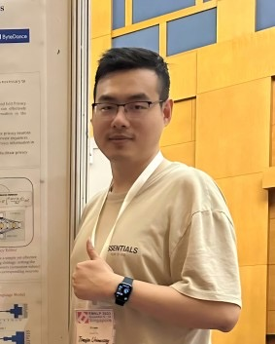








Final
Thanks to my supervisor and labmates
https://github.com/sdsxdxl/task_neurons
https://tjunlp-lab.github.io
Notes:
OK, this is the end of my presentation. I would like to express my special thanks to Professor Xiong and all the labmates in our lab, and all the reviewers and chairs for recognizing our study. Thanks again to all of you.

